Slide 1


2022-02-28
Python Multiprocessing
Accélérer votre programme | Speeding up you program
Présenté par : Jarno van der Kolk
it.uOttawa.ca
Notes:
PAGE COUVERTURE (option 3)
REMARQUE : À lire avant d’utiliser le gabarit
Les éléments suivants du gabarit ne peuvent pas être modifiés :
• En-tête institutionnel grenat (Université d’Ottawa | University of Ottawa)
• Pied de page institutionnel comprenant la bande grise et grenat ainsi que le logo
Les éléments suivants du gabarit peuvent être modifiés :
• L’adresse Web uOttawa.ca dans le pied de page peut être personnalisée afin de répondre aux besoins de l’utilisateur et le nom du document peut être inséré à la droite de l’URL si nécessaire. Vous pouvez simplement taper l’adresse Web désirée dans la boîte appropriée
• L’image ou la couleur de fond peut être remplacée par celle de votre choix
COVER PAGE (option 3)
NOTE: Read before using template
The following elements of the template must remain untouched and cannot be modified:
• Corporate (Université d'Ottawa | University of Ottawa) garnet header
• Corporate uOttawa footer including the grey/garnet stripe and logo
The following elements of the template may be customized:
• You may include the uOttawa.ca URL of your choice in the footer, and insert the name of the document to the right of the URL, if needed.
• The URL can be customized to a specific URL by following these simple steps: On the PowerPoint View tab, in the Master Views group, select Slide Master. Select the third slide on the left side panel, and type in the desired URL on the slide.
• The background image or colour may be replaced by the one of your choice

Slide 2
Use all the cores!
Modern processors have multiple cores available
Python uses only one
  Exception: some packages use multiple cores
Using N cores can potentially speed up your program by a factor of N
Multiple packages available
  Multiprocessing
  Threading

Slide 3
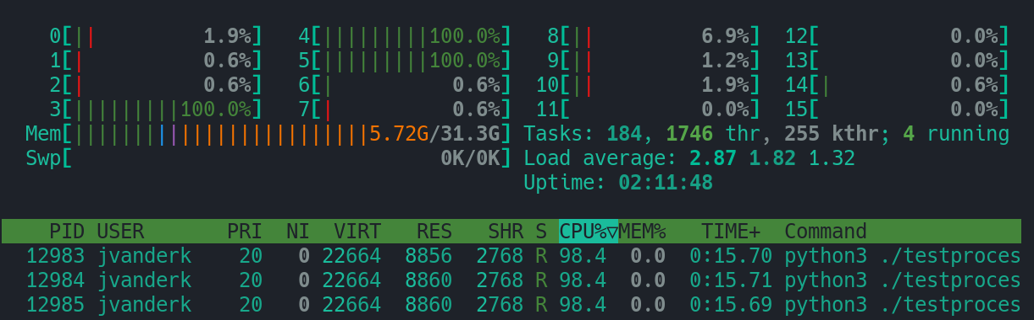
Example Multiprocessing
#!/usr/bin/env python3
from multiprocessing import Pool
def f(x):
for i in range(1000000000):
x = x + 1
return x*x
if __name__ == "__main__":
with Pool(5) as p:
print(p.map(f, [1,2,3]))

Slide 4
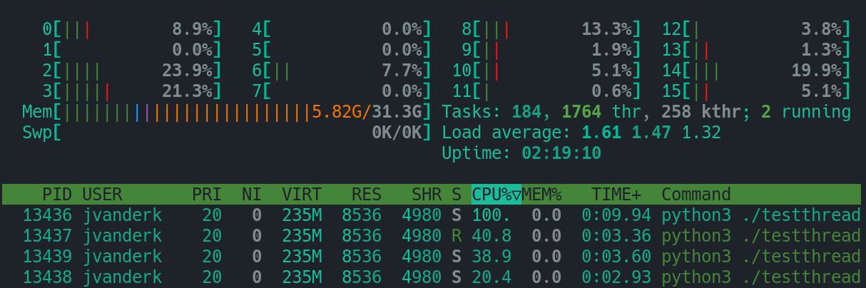
Example Threading
#!/usr/bin/env python3
import threading
def f(x):
for i in range(1000000000):
x = x + 1
return x*x
if __name__ == "__main__":
threading.Thread(target=f,args=(1,)).start()
threading.Thread(target=f,args=(2,)).start()
threading.Thread(target=f,args=(3,)).start()

Slide 5
Threading vs Multiprocessing
The threading package does not use multiple cores!
Takes three times as long
Use multiprocessing!
Threading is good for doing multiple things that wait for other things, e.g. web scraping

Slide 6
Multiprocessing Model
Start program
Programs are divided in serial and parallel parts
Serial execution
Begin parallel block
Process
Process
Process
Process
End parallel block
Serial execution
End program

Slide 7
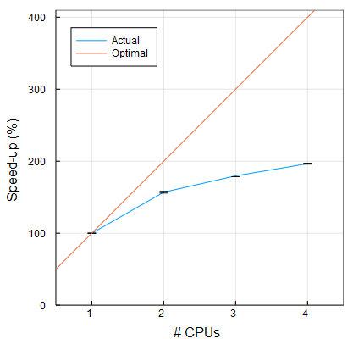
Scaling
Adding N processors does not make your program N times faster. (Amdahl’s law)
Reasons:
  Serial + Parallel blocks
  Management overhead
Measure it!

Slide 8
Multiprocessing Processes
Each CPU core has its own independent process
  Memory is not shared*
Each process runs a function
Processes need to be started
Join waits for the process to finish
def f(arg1, arg2, arg3):
# Do stuff
from multiprocessing import Process
p = Process(target=f, args=(1,2,3,))
p.start()
p.join()
*except on Linux, but only one way

Slide 9
Example – Random Walk
Simulating lots of particles doing Brownian motion
Want to know mean distance travelled

Slide 10
Code
def random_walk(seed, num):
stepsize = 0.01
random.seed(seed)
results = []
for trial in range(num):
x = 0
y = 0
z = 0
for step in range(10000):
phi = 2 * np.pi * random.random()
theta = np.arccos(2 * random.random() - 1)
x += stepsize * np.cos(phi) * np.sin(theta)
y += stepsize * np.sin(phi) * np.sin(theta)
z += stepsize * np.cos(theta)
results.append([x,y,z])
mean = 0
for result in results:
mean += np.sqrt(result[0]*result[0] + result[1]*result[1] + result[2]*result[2])
print(mean / num)
if __name__ == "__main__":
procs = [Process(target=random_walk, args=(i, 100)) for i in range(mp.cpu_count())]
for proc in procs:
proc.start()
for proc in procs:
proc.join()

Slide 11
Troubles with example
Each process just prints answer
Can’t collect result of function
Need way to get data
Enter Pool
def random_walk(seed, num):
...
return mean / num
if __name__ == "__main__":
with Pool(16) as p:
inputs = [[i, 100] for i in range(16)]
print(p.starmap(random_walk, inputs))

Slide 12
Basic Parallellizing
With just this technique you can quickly parallellize most programs.
But depends heavily on the problem.
Good
Bad

Slide 13
Advanced Parallellizing
What if the processes depend on each other
Can still work
Need interprocess communication
Good
Still Bad

Slide 14
Communication
Queues
  q = Queue()
  Place in queue
    q.put([1,2,3,4])
  Retrieve from queue
    q.get()
Useful for things that generate things that need to be processed by other things
Pipes
  p = Pipe()
  Send in pipe
    p[0].send([1,2,3,4])
  Receive from pipe
    p[1].recv()
Useful for inter-process communication when working on something together

Slide 15
Queue Example
Want to analyze text in books
Read book, analyze data, read next book, analyze data...
Now with multiprocessing!
time
time
Code

Slide 16
Queue Warnings!
Avoid dead locks!
  Every put() must have a get()
  Dead lock = process 1 waits for process 2 while process 2 waits for process 1.
Don’t create more processes than you have CPU cores
  Use Pool instead

Slide 17
Pipe Example
Running simulation of heat equation on a grid
Each process handles part of the domain
Communicate boundary values
Process 1
Process 2

Slide 18
Pipe Example
1D Heat equation with non-insulating boundary conditions
Discrete form

Slide 19
Pipe Example
Translation to Python
for i in range(steps):
for n in range(1, size+1):
future_domain[n] = domain[n] +
coeff * (domain[n-1] - 2*domain[n] + domain[n+1]);

Slide 20
Local boundaries
Process 1
Process 2
Process 1
Process 2
New cell is based on left and right neighbour

Slide 21
Local boundaries
Process 1
Process 2
Process 1
Process 2
Exchange information after every time step

Slide 22
Local boundaries
if left_pipe != None:
left_pipe.send(domain[1])
domain[0] = left_pipe.recv()
if right_pipe != None:
right_pipe.send(domain[-2])
domain[-1] = right_pipe.recv()
Process 1
Process 2
Process 3

